Slide 1
Nuclear Fuel Performance
NE-533
Spring 2022

Slide 2
Last Time
Fuel and pellet conditions change with time due to microstructure evolution
All materials have defects, radiation damage causes many more defects
Microstructure can be tailored through processing
Thermal conductivity degrades with time
High Burnup Structure can form along the rim
Started on some fuel chemistry

Slide 3
UO2 Radiation effects

Slide 4
Thermal Conductivity Degradation
The physical effects caused by atomic displacements are rather complex and depend on the relative sink strengths of a given material for interstitials and vacancies and on the temperature
The defects that survive migrate through the crystal lattice where they cluster to form extended defects like dislocation loops, lines and networks, which can potentially be absorbed in grain boundaries, gas bubbles or precipitates, which act as sinks
Damage by fission also leads to changes in chemistry due to production of fission products
One of the major effects of defect formation is the degradation of thermal diffusivity, due to phonon scattering
Results obtained on irradiated UO2 show that the thermal conductivity is decreasing with increasing burn-up, and that at equal burn-up, samples with higher irradiation temperatures have higher thermal conductivity

Slide 5
Thermal Conductivity Degradation
There are mesoscopic and atomistic features that affect the thermal conductivity
The porosity existing in fresh fuels evolves during irradiation and has a strong impact on heat transport, because voids/bubbles have significantly lower kth than the lattice
Precipitates are formed by fission products that are insoluble in the UO2 lattice, forming oxide or metallic inclusions: can use composite theory to get effective thermal conductivities; typically, these precipitates INCREASE the thermal conductivity of the fuel
Actinides, rare earths, and transition metals can form mixed oxides with UO2 (soluble fission products): these atoms act as phonon scattering centers as a result of the differences in bonding, radii, or mass, and thus decrease kth
Volatile fission products/gases are partially in solution and partially in bubbles, where they act as phonon scatterers or as low kth composite fractions
Point defects and extended defects contribute to the degradation of the thermal conductivity by scattering or limiting the mean free path of the phonons

Slide 6
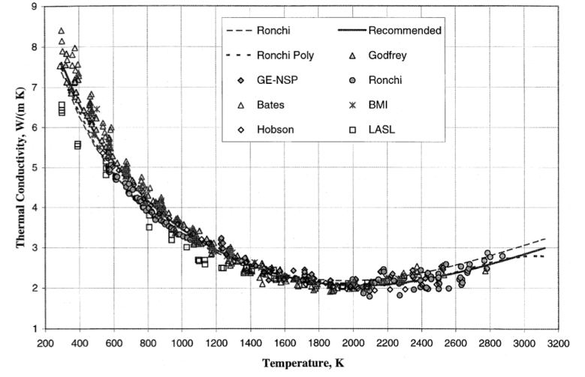
UO2 Thermal Conductivity
We have established correlations for thermal conductivity of fresh UO2 fuel as a function of temperature
Where t = T/1000
The first part of the equation describes the phonon interactions
The second part describes electronic transport which becomes significant at high temperature

Slide 7
UO2 Thermal Conductivity
UO₂ thermal conductivity is low and decreases more during reactor operation
The thermal conductivity has been collected after various amounts of burnup to make empirical fits

Slide 8
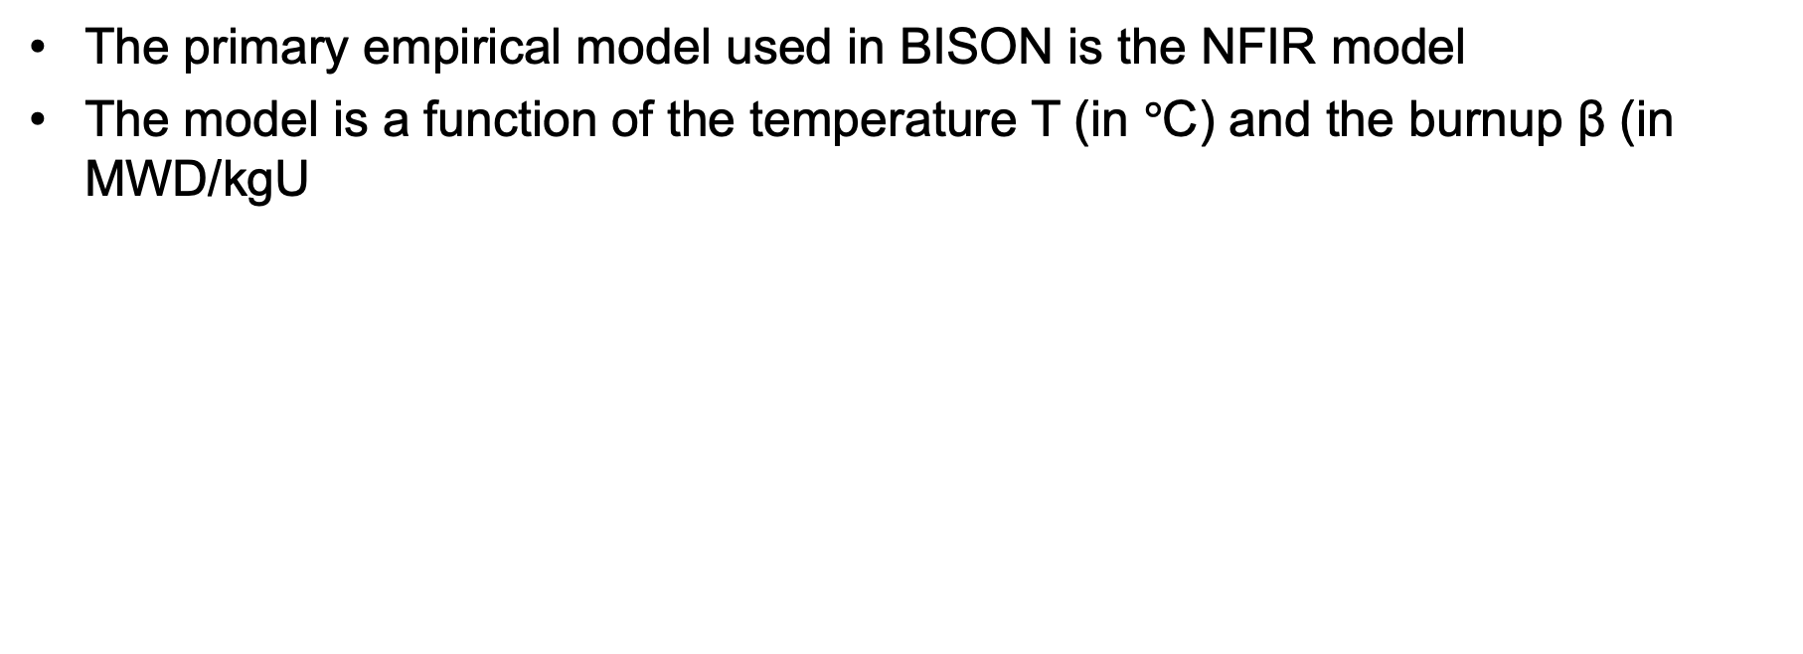
UO2 Thermal Conductivity
The primary empirical model used in BISON is the NFIR model
The model is a function of the temperature T (in $°$C) and the burnup β (in MWD/kgU

Slide 9
UO2 Thermal Conductivity
The R_{f} function switches between two k_{ph} functions

Slide 10
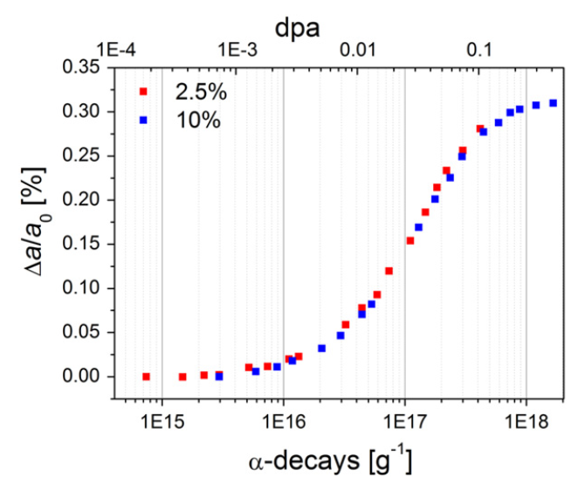
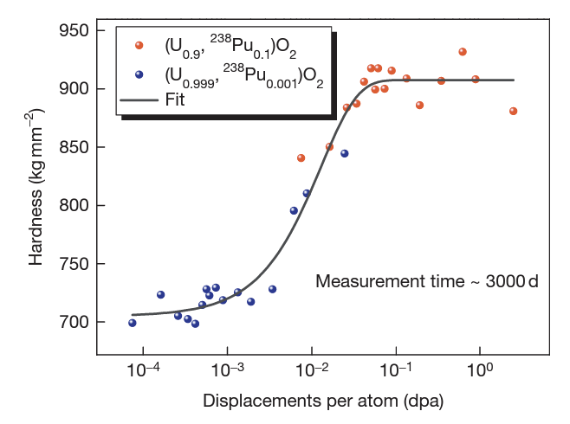
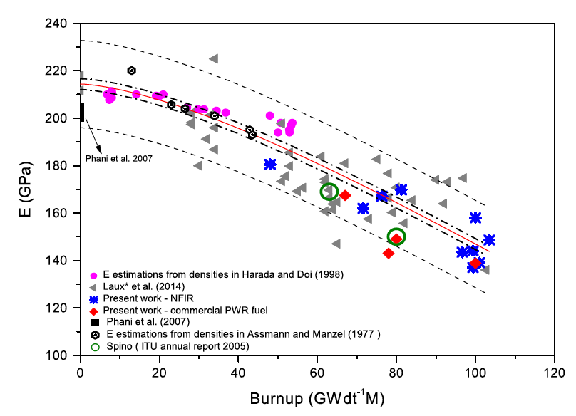
Physical Changes
An important effect of radiation damage is the volume increase of the crystal lattice, leading to macroscopic swelling of the fuel material
Alpha particle damage alone can cause approximately 0.4% swelling
Mechanical properties also vary with damage, increasing with dpa
UO2 does not become amorphous, but damage accumulation can eventually cause polygonization: transformed into a material consisting of very small grains

Slide 11
High Burnup Structure (HBS)
In the late 1950s, it was observed that a strong capture of neutrons by U-238 in the resonance range occurs at the periphery of the fuel
This leads to the production of Pu-239, and leads to a higher fissile density and thus an increase in the local burnup
This high local burnup area is on the outer ring of the fuel and is about 200 microns thick, which represents about 8% of the fuel
This leads to microstructure changes…

Slide 12
High Burnup Structure (HBS)
When thermal recovery is not sufficiently efficient (at lower temperatures), the accumulation of defects at high burnup can lead to the instability of the crystalline structure, initiating a restructuring driven by the energy stored in the material
In UO2, grains subdivide from 10microns in size to 100-200 nm size, and a densely porous structure is formed (~20% porosity)

Slide 13
High Burnup Structure (HBS)
The increase of the relative porosity volume degrades the material conductivity and reduces the mean grain size
On the other hand, the intragranular irradiation defect-cleaning improves the fuel intrinsic thermal conductivity
Fission gas in HBS bubble is retained, not released
Exact mechanism of HBS formation is not understood

Slide 14
Summary
Radiation damage leads to accumulation of defects in UO2, changing properties and microstructure
Thermal conductivity degrades with time
High Burnup Structure can form along the rim

Slide 15
Fuel chemistry

Slide 16
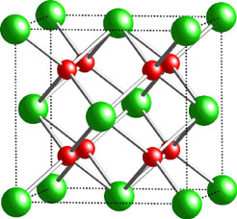
Fuel Chemistry
UO₂ is an ionic compound that must have balanced charges
What is the charge of a typical oxygen ion?
O²⁻
Uranium valance states
Possible: U³⁺, U⁴⁺, U⁵⁺, U⁶⁺
Most stable: U⁴⁺, U⁵⁺, U⁶⁺
Beyond UO2, can have U4O9, U3O8, UO3
The structure is very stable all the way up to the melting temperature and down to extremely low temperatures, even with irradiation damage
There is space in the uranium lattice that can accommodate fission products

Slide 17
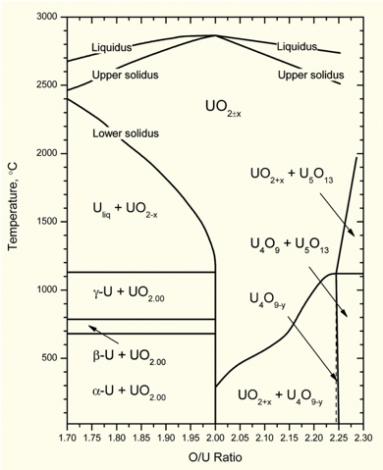
O/M ratio
The ratio of oxygen to uranium metal (O/M ratio) can vary
This is the stoichiometry
The homogeneity range of uranium dioxide extends to both hypo- and hyperstoichiometric compositions in oxygen
The minimum and maximum oxygen contents in the dioxide correspond to the compounds with the formula of respectively UO_{1.67} at 2720 K and UO_{2.25} at approximately 2030 K
Will the O/M ratio go up or down during reactor operation?
It is complicated, because of the formation of fission products that also react with the oxygen, and O interaction with Zr cladding

Slide 18
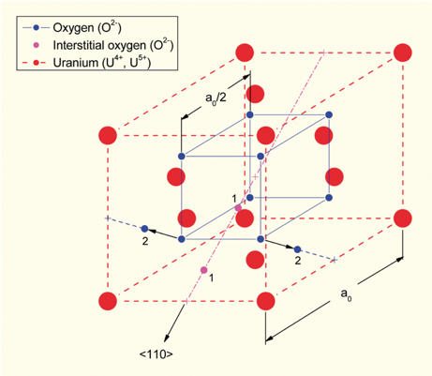
Excess O
The crystal structure of UO₂ can accommodate extra oxygen
Excess oxygen resides at interstitial locations
Oxygen in neighboring sites is displaced
Cation valence increases to maintain electrical neutrality
Fuel fabricated to be nearly stoichiometric; i.e., UO2.00± because:
It is the most stable
It has the highest melting temperature
[after Olander, 1976]

Slide 19
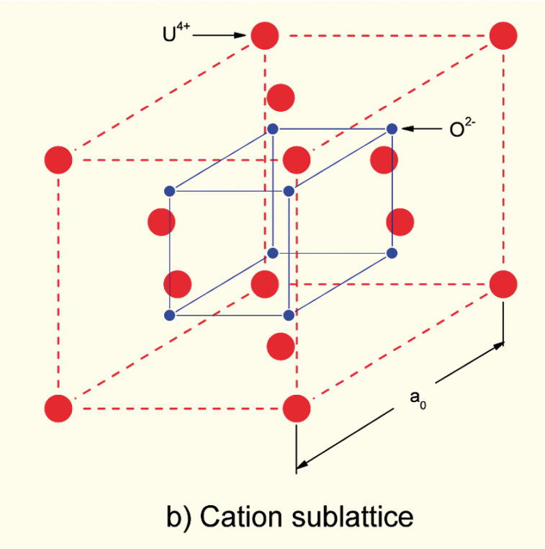
Incorporation of Fission Products
As fission products form, the valence state of the uranium can change
Typical valence of soluble fission products is M³⁺
The uranium valence state changes to compensate
Oxygen liberated by fission
Fission products produced with M³⁺ valance state incorporated in fuel lattice
Uranium oxidizes from U⁴⁺ to U⁵⁺ or U⁶⁺ to maintain local electrical neutrality

Slide 20
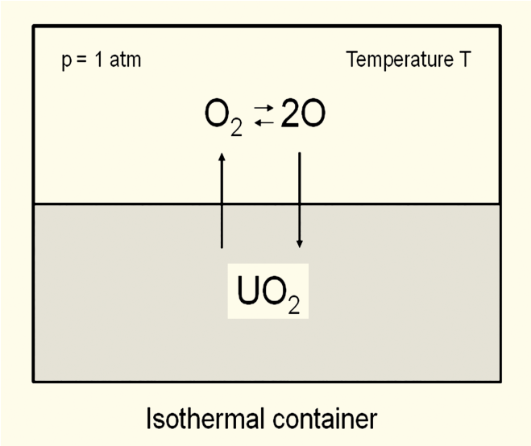
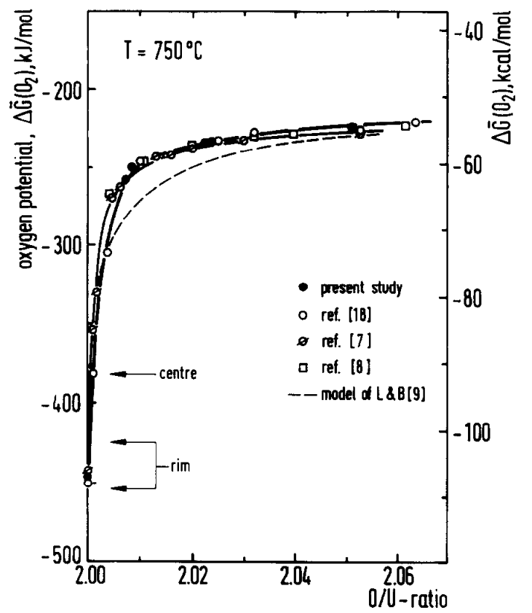
Oxygen potential
The oxygen potential is a measure of how free the oxygen is to escape/move around
Oxygen potential is defined as:
or, equivalently:
With = Chemical potential of oxygen in solution
= Gibbs free energy of gaseous oxygen at temperature T and a standard pressure (1 atm)
It is possible to determine the stoichiometry from the oxygen potential

Slide 21
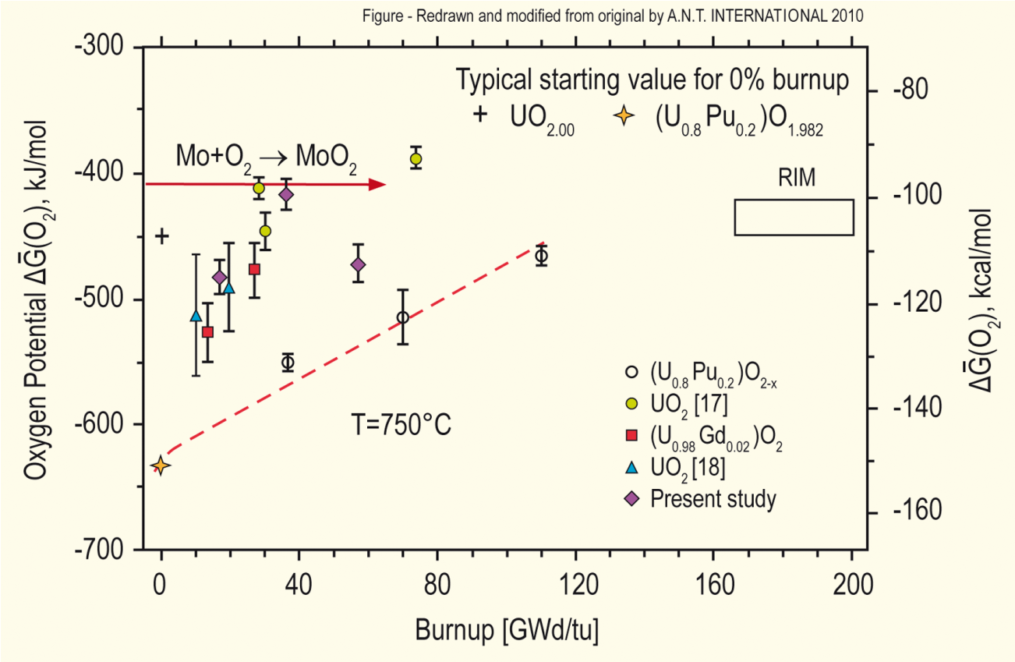
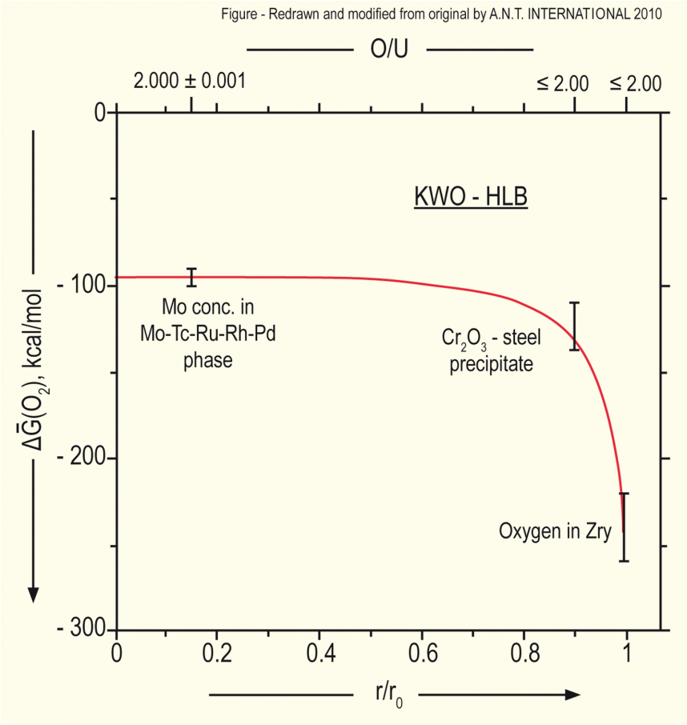
Oxygen potential
The oxygen potential changes during irradiation, indicating change in the O/M ratio
Oxygen potential changes during irradiation due to
Liberation of oxygen by fission; Generation of fission products; Conversion of uranium to plutonium; Reaction of oxygen with U, Pu, fission products, and cladding
Oxygen potential across pellet radius observed to be constant at the approximate value of Mo/MoO₂ reaction (from calculations)
Mo serves as a buffer to the O potential, or a means of inferring what the oxygen potential may have been in the fuel from PIE
Oxygen potential is low near the cladding, because the oxygen enters the cladding

Slide 22
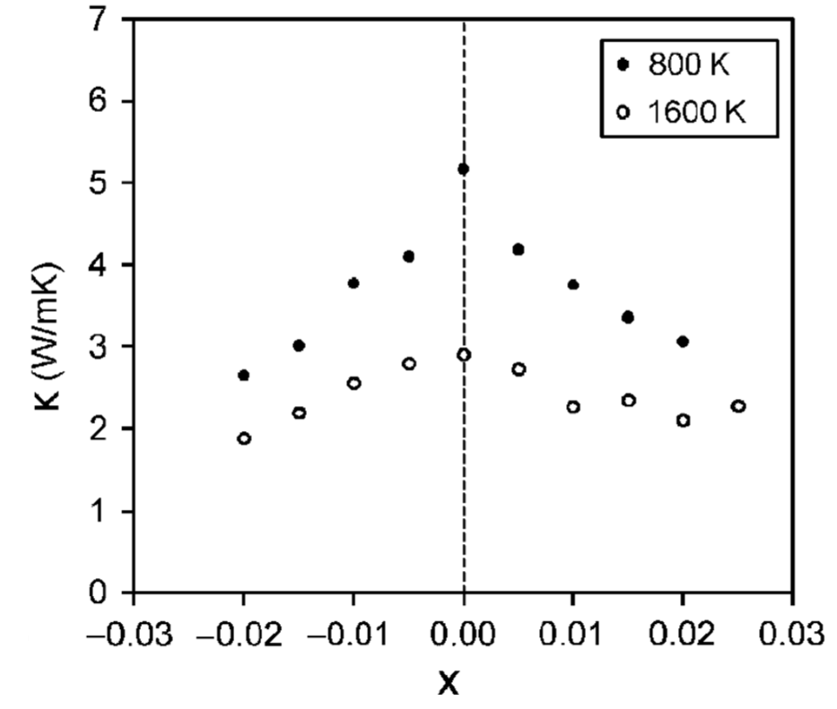
Fuel Stoichiometry/Properties
The stoichiometry of the fuel directly impacts the fuel performance
Stoichiometry impacts
Melting temperature
Thermal conductivity
Processes dependent on diffusion
Grain growth
Fission gas release
Creep
Chemical state and behavior of fission products
Chemical reactions at inner cladding surface
Thermal conductivity is highest for stoichiometric UO2

Slide 23
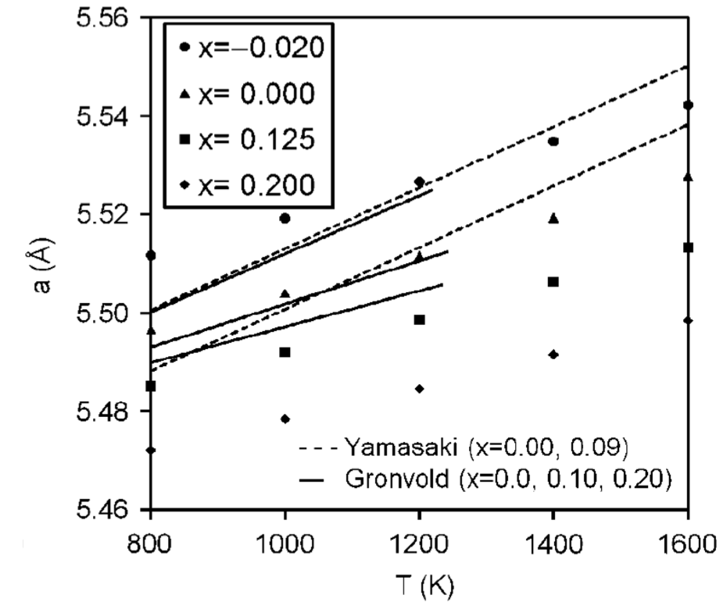
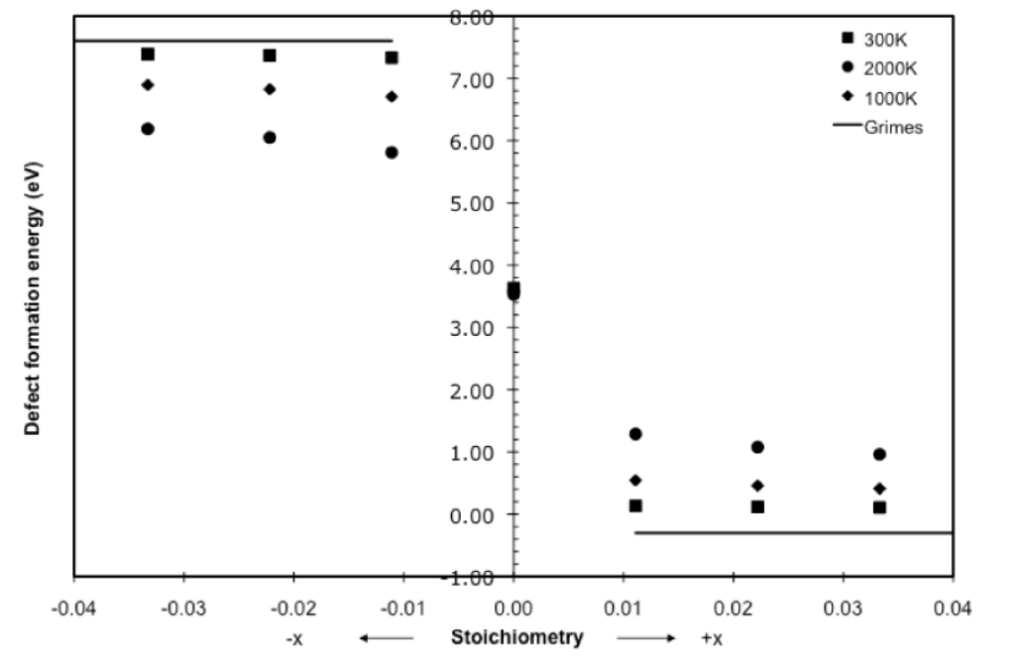
Fuel Stoichiometry/Properties
The lattice constant of the material decreases with increasing stoichiometry
The vacancy formation energy also changes with stoichiometry

Slide 24
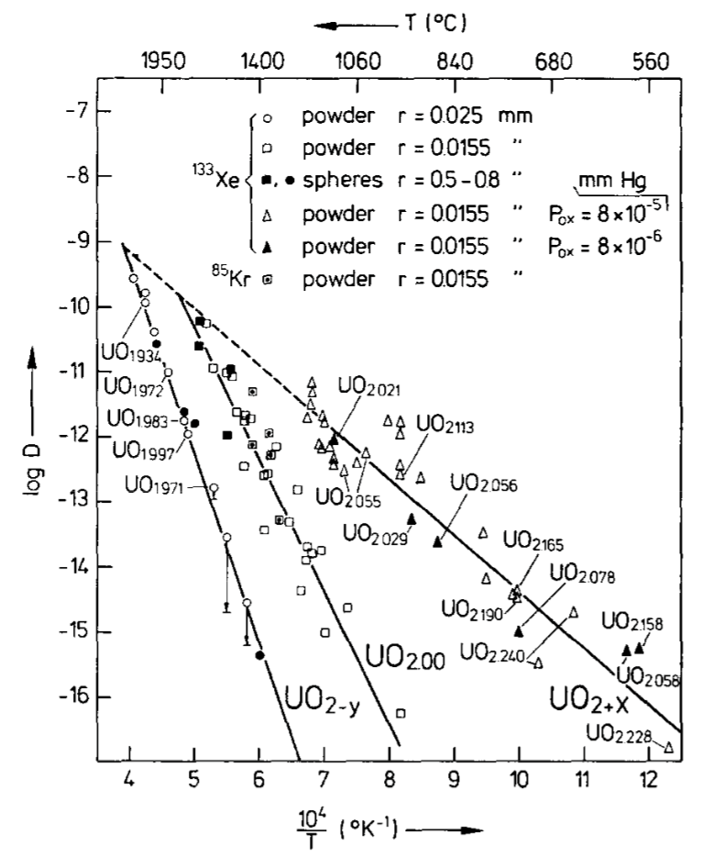
Fuel Stoichiometry/Properties
Fission product | UO_{1.97} | UO₂ | UO_{2.03}
Xe | 3.88 eV | 3.88 ev | 2.61 eV
Cs | 1.7 eV | -0.04 eV | -3.29 eV
Sr | -3.71 eV | -6.03 eV | -9.55 eV
The solution energy of Xe, Cs, and Sr in UO₂ depends on stoichiometry as well
The coefficient defining Xe diffusion also changes with stoichiometry
Though stoichiometry matters, most fuel performance codes ignore it

Slide 25
Fuel Chemistry Summary
UO₂ has a cubic fluorite structure that is very stable
The charges are balanced with a U⁴⁺ valence state
However, the ratio of oxygen to uranium can change. We call this the stoichiometry and abbreviate it as O/M ratio
The O/M ratio changes during reactor operation, but it is complicated
The O/M ratio impacts many properties of the fuel

